Slide 1
Improving Energy Demand Forecasting for Better Procurement & Grid Efficiency
The company faced unpredictable load fluctuations across regions, leading to:
Higher peak procurement costs
Energy supply-demand imbalance
Billing mismatches (supplied vs billed energy)
Objective:
Develop a data-driven forecasting system to accurately predict daily and short-term energy demand, reduce wastage, and improve billing efficiency.
Data used:3 years of smart meter data (2021–2023) from 5 metro cities.

Slide 2
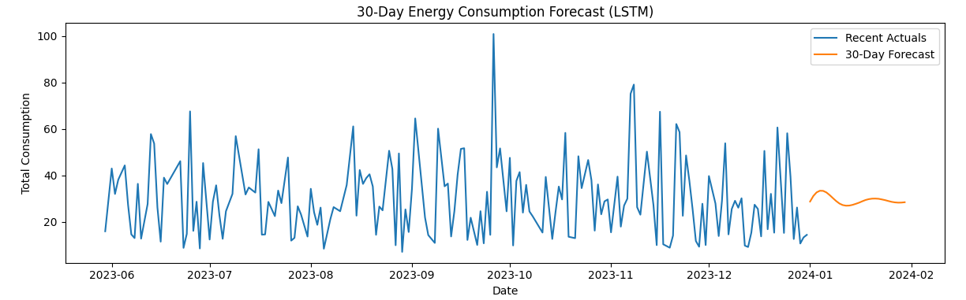
Deep Learning Approach: LSTM for Energy Load Forecasting
Why LSTM?
Traditional models struggle with complex, nonlinear patterns in energy demand (e.g., weekends, weather effects, random surges).
LSTM networks can learn long-term dependencies and time-based fluctuations efficiently.
Pipeline Overview:
Data Aggregation – Converted raw readings to daily total consumption per city.
Preprocessing – Filled missing values, normalized data, created 30-day lookback sequences.
Model Architecture –
  LSTM(64) → Dropout(0.2) → Dense(16) → Output(1)
  Optimizer: Adam, Loss: MSE
Evaluation Metrics: MAE, RMSE, MAPE

Slide 3
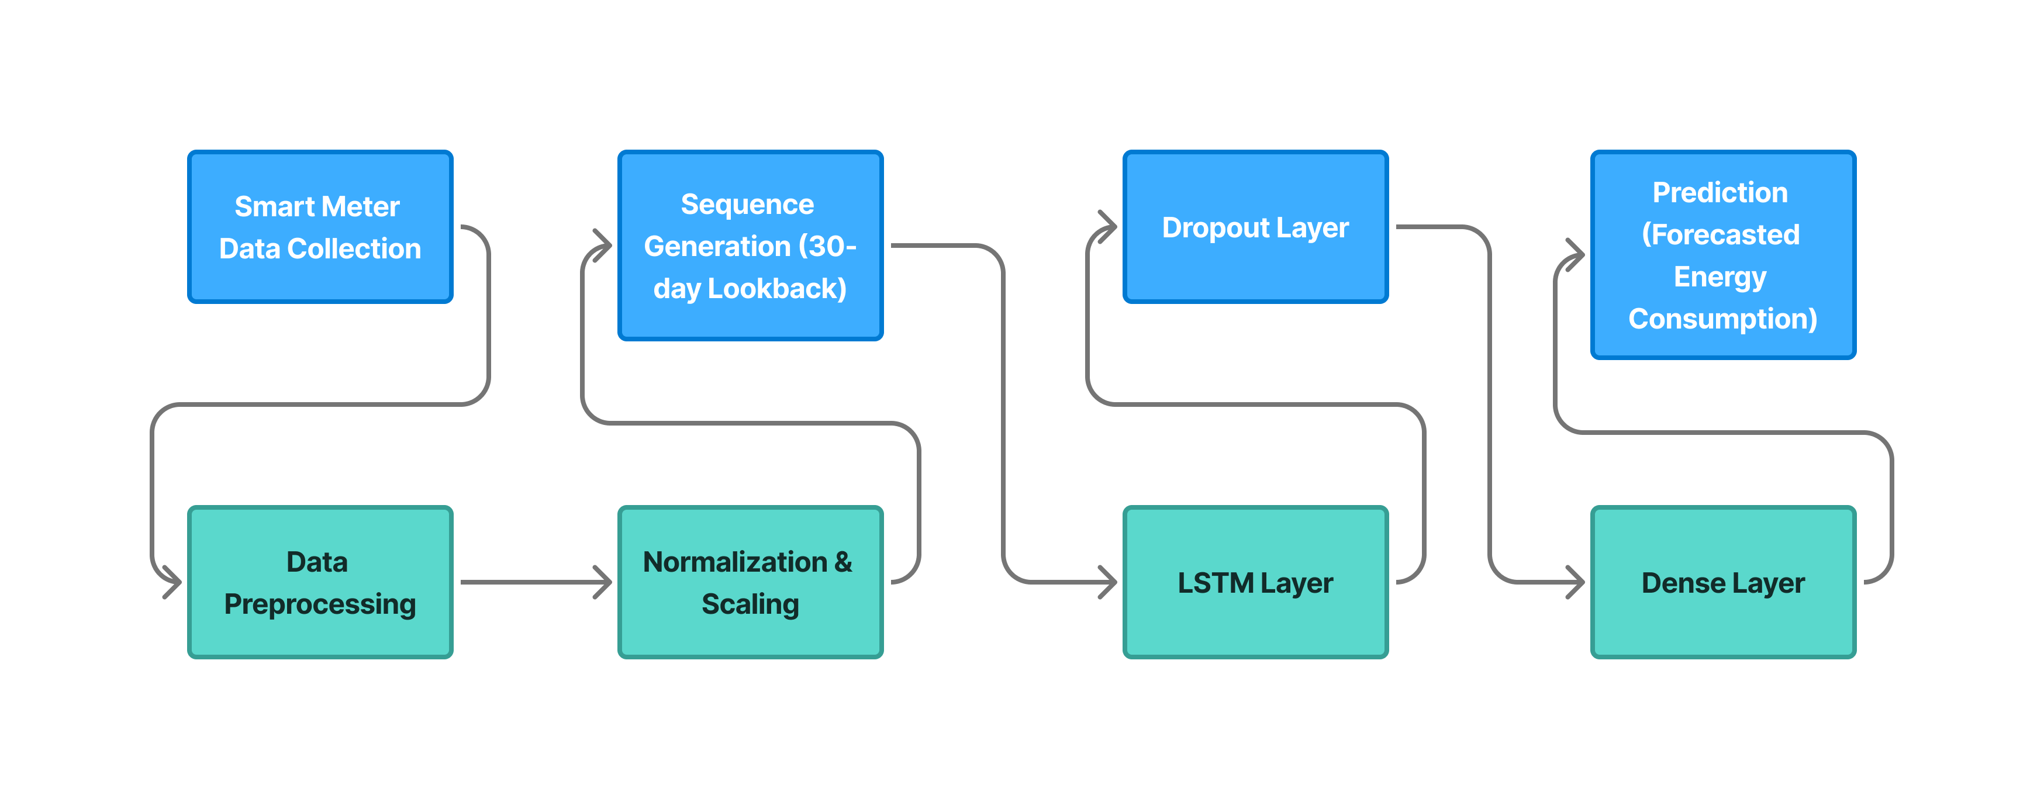
Model Workflow

Slide 4
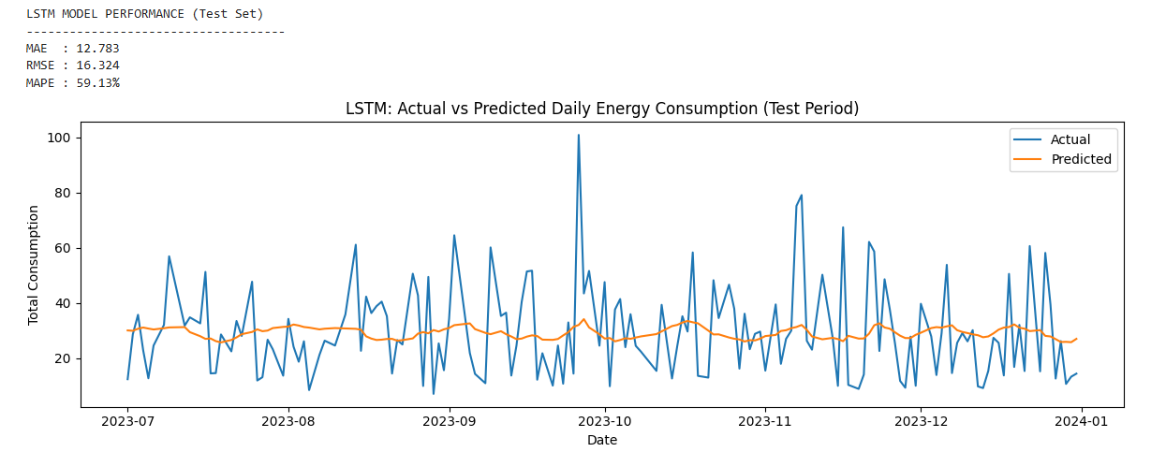
Forecasting Results & Key Insights
Pattern Insights:
Energy consumption exhibits a strong weekly pattern (lower on weekends).
Clear seasonal peaks during summer months (April–June) and dips during Feb.
Stable growth trend from 2021 → 2023.
Gap between Supplied energy and billed energy(Potential area of lowering cost).
MAE | 12.783
RMSE | 16.324
MAPE | 59.13%

Slide 5
Translating Forecast Accuracy into Operational Advantage
Procurement Optimization:
Forecasts enable proactive energy purchase planning, avoiding excess procurement.
Estimated 5–8% cost reduction in energy procurement.
Load Management:
Improved short-term visibility reduces overload risk and ensures steady supply.
Facilitates maintenance scheduling and peak load management.
Revenue Enhancement:
Forecasted demand helps align energy billed with energy supplied, minimizing leakage and improving billing accuracy.

Slide 6

Comprehensive Dashboard

Slide 7
Next Steps: Operationalizing the Forecasting System
Immediate (0–3 Months):
Deploy trained LSTM model in production for daily forecast updates.
Integrate output with Superset dashboard and alert system.
Short Term (3–6 Months):
Enhance model with weather and temperature data to boost accuracy.
Introduce real-time anomaly detection (flag unexpected consumption spikes).
Long Term (6–12 Months):
Scale forecasting to hourly granularity for demand-response optimization.
Use model insights to inform dynamic pricing and load balancing strategies.

